Slide 1

Agile versus Waterfall Project Management
Decision Model for Selecting the Appropriate Approach to a Project

Slide 2

Group-4: Team Members
Name
ID
Stream
Abubeker Juhar
UGR/3857/15
Software
Blen Berhanu
UGR/8682/15
Software
Eyerusalem Geremew
UGR/2359/15
Software
Nahom Zenebe
UGR/0216/15
Software
Samuel Teferi
UGR/1535/15
Software

Slide 3

Evaluating the Title's Suitability
This title effectively communicates the research's focus and objectives.
Clear Comparison
Key Deliverable
Target Audience
Explicitly highlights the Agile vs. Waterfall project management debate.
Promises a practical decision model for approach selection.
Implies relevance for practitioners making methodological choices.
Title Evaluation: Comprehensive Assessment
The title clearly reflects the comparison between Agile and Waterfall methodologies.
It communicates the core research output: the development of a decision model.
It indicates a practitioner-focused context, guiding those facing methodology choices.
The title adequately conveys the research scope and methodological approach, setting clear expectations for the reader.

Slide 4
Introduction: Purpose of the Final Paragraph
Structural Outline
The final paragraph clearly outlines the structure of the paper, providing a roadmap for readers.
Reader Guidance
It guides readers by previewing subsequent sections, enhancing readability and comprehension.
Establishes Flow
It establishes a logical flow, transitioning from literature review to methodology, findings, model, and conclusion.
Ensures Clarity
This section ensures clarity and prepares readers for the progression of ideas and arguments.

Slide 5
Abstract: Study's Core Components
Overall Purpose of the Study
Methods Used
Literature Review: Systematic analysis of existing research (Vom Brocke et al., 2009).
To develop a practical decision model that assists project managers in selecting between Agile and Waterfall approaches for specific projects.
Empirical Data Collection: 15 expert interviews across multiple industries in Germany.
Research Problem
Model Development: Based on Adam's (1996) modeling process, resulting in a 15-criteria framework across five categories.
Existing literature lacks a systematic, empirically supported decision model for practitioners to select the most suitable project management methodology in concrete project scenarios.

Slide 6



Abstract: Key Findings & Conclusions
Main Findings: Decision Model Categories
Scope
Time
Costs
Organizational Context
Project-Team Characteristics
The model closes a significant research gap, proving both scientifically and practically relevant. Expert insights ensure real-world applicability.
Interpretations & Conclusions
The model is scientifically grounded and practitioner-friendly, enabling informed selection of Agile, Waterfall, or hybrid approaches. It contributes to project management research by providing a structured tool for real-world project planning and successful execution.

Slide 7
Introduction: Methodologies & Challenges
1
2
3
Core Models
Problem Statement
Practitioner Challenge
Two primary models exist: Plan-driven (Waterfall) and Agile.
Clearly states the challenge of choosing between Agile and Waterfall, linking methodology choice to project success.
Organizations struggle with methodology selection, leading to project inefficiencies and potential failures.
Hybrid Models: An emerging approach integrates elements of both for a balanced solution.
4
5
Research Gap
Research Contribution
A critical lack of empirically validated decision models grounded in real-world expert input.
This study directly addresses this gap, providing an evidence-based and user-oriented tool for project managers.

Slide 8
Introduction: Research Approach & Aims
Methodological Approach
Cross-Industry Applicability
Literature Review: Comprehensive analysis of existing academic and industry publications.
The model's versatility ensures broad usefulness across various sectors.
Expert Interviews: Qualitative data collection from experienced professionals for real-world insights.
Project-Specific Framework
Goal: Develop a tailored decision framework, moving beyond one-size-fits-all solutions.
Model Development: Structured creation of a decision framework based on collected evidence.
Study's Aims & Research Questions
RQ1: Comparative Analysis
Compares Agile vs. Plan-driven methods from a practitioner's viewpoint, highlighting their practical implications.
RQ2: Decision Model Development
Develops a robust decision model for selecting the most appropriate project management approach.

Slide 9
AGILE VS. WATERFALL: SIDE-BY-SIDE COMPARISON
WATERFALL (PLAN-DRIVEN)
AGILE
Approach
Approach
• Linear, sequential phases
• Upfront comprehensive planning
• Iterative sprints & cycles
• Continuous adaptive planning
KEY CHARACTERISTICS
• Documentation-heavy
• Fixed scope & requirements
• Clear responsibilities
• Easy progress tracking
KEY CHARACTERISTICS
• Collaboration-heavy
• Flexible & evolving requirements
• Customer-focused feedback
• Frequent deliverables
ADVANTAGES
Predictable timelines & costs
Ideal for stable requirements
Best for critical projects (safety, compliance)
ADVANTAGES
High adaptability to change
Continuous product delivery
Strong client collaboration
Early issue discovery

Slide 10
AGILE VS. WATERFALL: SIDE-BY-SIDE COMPARISON
WATERFALL (PLAN-DRIVEN)
AGILE
DISADVANTAGES
Hard to incorporate changes
Late testing = late issue discovery
Inflexible for unclear needs
DISADVANTAGE
Difficult scope management
Requires experienced teams
Not suitable for vague/unstable requirements
BEST FOR
Dynamic, evolving projects
Customer collaboration projects
Innovation & rapid delivery
BEST FOR
Well-defined projects
High-risk (aerospace, etc.)
Fixed budget & scope

Slide 11



Bridging the Gap: The Need for a Decision Model
The primary motivation for this research is the lack of a practical, empirically grounded decision model to help practitioners select between Agile and Waterfall project management approaches for specific projects.
This study aims to address a gap in project management by providing a clear, evidence-based model to help practitioners choose the most suitable project methodology instead of relying on intuition.
The Research Imperative: Why Methodology Matters
Unvalidated Decision-Making
Impact of Poor Selection
Consequences

Slide 12
Research Design & Methodology: Modeling Process
The development of the decision model rigorously followed the established modeling process put forth by Adam, D. (1997), ensuring a systematic and well-founded approach to its creation.
Correctness
Relevance
Ensuring the model accurately reflects real-world scenarios and principles.
Guaranteeing the model addresses pertinent issues for practitioners.
Economic Efficiency
Clarity
Designing the model to be practical and resource-effective in application.
Making the model easily understandable and actionable for all users.
Comparability
Systematic Structure
Allowing for straightforward comparison across different project contexts.
Building the model with a logical and coherent framework.

Slide 13
Expert Perspectives: Unpacking Methodological Differences
Interview partners, primarily seasoned project managers, were asked to rate the significance of differences between classical Waterfall and Agile methods across six key domains. They provided rationales for their rankings, ranging from "no difference (0)" to "high difference (3)."
From the project managers' viewpoints, the most significant distinctions between the two approaches primarily lie in their fundamental planning character. This suggests that the approach to foresight and adaptation is a core divergence.

Slide 14
Research Design & Methodology
The authors developed a two-step decision framework to guide methodology selection:
Step 1: Exclusion Criteria
A project may not be suitable for Agile if it has one or more of the following characteristics:
Lack of Decomposability
The project cannot be broken into small, independent deliverables.
One-Shot Nature
Legal or technical constraints prevent iterative or incremental development, or changes would cause excessive cost.
High Project Criticality
Operational or safety risks do not allow frequent changes or experimentation.
Organizational or Sponsor Constraints
Limited Agile support or a rigid, inflexible organizational culture.

Slide 15
Research Design & Methodology
Step 2: Detailed Scoring of Criteria
If agile is not excluded based on the step1 , we are going to evaluate against 15 criteria across 5 categories:
Scoring Scale (0–4): High score = favors waterfall Low score = favors agile
Categories: Scope, Time, Budget ,Organization, Project Team
The model supports custom weighting of decision categories based on project context. Expert interviews indicate that Project Scope, Organizational Context, and Project Team Characteristics are the most influential factors, while Time and Budget are generally less decisive in selecting a project methodology.

Slide 16
Key Findings: Agile vs. Waterfall Distinctive Features
Agile
Waterfall
Flexibility: Highly adaptable to evolving requirements.
Structure: Linear, sequential phases with distinct milestones.
Customer Involvement: Continuous feedback and collaboration with stakeholders.
Predictability: Strong emphasis on upfront planning and fixed scope.
Iterative Development: Delivers functional increments frequently.
Documentation: Extensive documentation at each stage.
These findings align directly with the research goal of systematically comparing methodologies. The insights highlight real project scenarios that justify the observed differences and their implications for project outcomes.

Slide 17
Discussion: Interpreting the Findings
The findings are interpreted in relation to existing knowledge about software project outcomes, providing context and validating the empirical observations.
The research showcases the specific benefits of Agile methodologies, particularly in dynamic and rapidly changing project environments.
It clarifies the continued suitability of Waterfall for projects with fixed scopes, clear requirements, and predictable outcomes, where comprehensive upfront planning is feasible.
The study offers fresh insights into the potential of hybrid models, demonstrating how Agile practices can be partially integrated within traditional Waterfall structures to enhance adaptability without sacrificing control.

Slide 18
Conclusion & Implications: Charting the Future of Project Management
Research Accomplishments
Research objectives met? Yes—a comprehensive model was developed, and key differences analyzed.
Research questions answered? Yes—RQ1 (methodological differences) and RQ2 (decision model) were thoroughly addressed.
Main Findings
Planning Style: The most significant differentiator between Agile and Waterfall is their approach to planning.
Two-Step Model: A novel two-step decision model significantly improves clarity in methodology selection.
No Universal Solution: There is no "one-size-fits-all" method; context dictates the optimal approach.

Slide 19
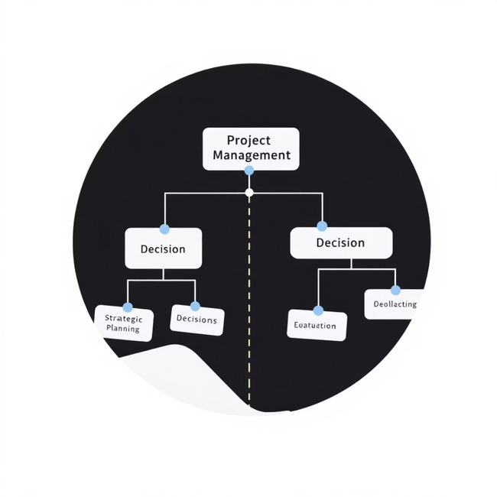
Implications for Software Project Management
For practitioners: Utilize the model during project kick-offs to foster stakeholder alignment and make informed decisions.
For researchers: Extend the model with quantitative validation and explore AI-based tuning for enhanced accuracy and applicability.

Slide 20
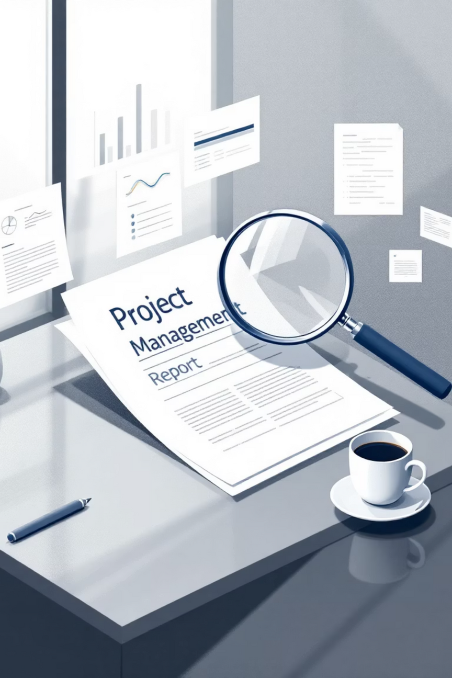
Overall Review: Evaluating a Project Management Decision Model
Strengths
Clear, practical model for project methodology selection.
Well-structured and transparent research process.
Strong alignment with critical practitioner needs in the field.
Weaknesses
Limited sample size restricts generalizability of findings.
Absence of robust quantitative data for empirical validation.
Ethical considerations in research design not explicitly addressed.

Slide 21

Literature Review – A Critical Evaluation
The literature review effectively establishes a strong motivation, highlighting the critical lack of a validated decision model for project methodology selection. It references 52 sources, indicating thorough background research.
However, the review is largely descriptive, often summarizing existing works without deeply critiquing conflicting findings or engaging in analytical comparisons.
While it supports the foundational motivation, a deeper theoretical comparison would strengthen its scholarly contribution.

Slide 22


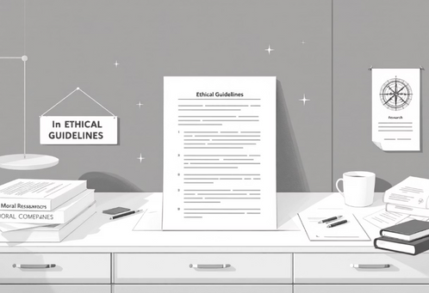
Methodology – Design, Limitations, and Ethics
1
2
3
Strengths
Weaknesses
Ethics
Leveraged multi-industry expert interviews.
The modeling framework is presented with clear, logical steps.
Small sample size .
Demographic diversity of participants was also constrained.
informed consent and data anonymization, were not explicitly discussed in the paper,
While replication is theoretically possible, the interview protocol details provided are insufficient to fully reproduce the study with fidelity.

Slide 23

Results – Clarity and Consistency Assessment
The reported results demonstrate :
strong alignment with the research questions, particularly RQ1 concerning methodology selection criteria.
They clearly present the differences, advantages, and disadvantages of various project management approaches.
Alignment and Presentation
Visuals vs. Statistics
Visual figures effectively support:
the clarity of the presented model, making complex relationships accessible. However, these visuals generally lack statistical depth or quantitative validation.
The findings are predominantly qualitative, relying heavily on expert judgment and practitioner experience, which is valuable but highlights a need for future quantitative backing.

Slide 24




Major Inputs for Software Project Management Careers
Decision Factors
The paper teaches crucial decision factors for choosing appropriate project methodologies, providing a structured framework for selection.
Agile vs. Waterfall
It significantly enhances understanding of the trade-offs between Agile and Waterfall approaches, detailing their respective benefits and drawbacks.
Context & Team
Reinforces the critical importance of organizational context, culture, and team capability in successful project execution.
Practical Application
Offers practical utility for project planning, risk assessment, and the strategic application of hybrid project models.

Slide 25
Recommendations for Future Action
Structured Validation
Organizations should implement structured criteria to validate their methodology choices, moving beyond informal selection processes.
Cultural Readiness
Focus on improving cultural readiness and organizational agility to better support the adoption of Agile methodologies.
Adaptive Weighting
Adjust the weighting of project selection criteria based on specific project environments and strategic objectives.
Hybrid Models
Actively implement hybrid project models where they can leverage the strengths of both traditional and agile approaches.

Slide 26





Further Research Issues Identified
Quantitative Validation
There is a significant need for quantitative validation of the decision model using large datasets across diverse projects.
Software-Only Environments
Future research should specifically explore the model's applicability and effectiveness within purely software development contexts.
AI-Based Decision Support
Investigate the potential for integrating Artificial Intelligence (AI) to enhance the model's decision-making capabilities.
Cultural Maturity Impact
Assess the impact of cultural maturity levels on methodology selection and project success across various industries.

Slide 27





Additional Reviewer Insights
The paper offers a strong conceptual contribution by providing a structured decision model for project methodology selection, a critical gap in current literature. However, it currently lacks empirical robustness.
PM Advancement
It significantly advances project management understanding by offering clear, structured selection criteria that practitioners can readily apply.
Model Utility
The decision model is highly useful, but its effectiveness could be further enhanced by incorporating decision trees for more complex scenarios.
Practical Insights
The paper fills a void by delivering practical insights often missing in more theoretical comparative studies of project methodologies.

